Slide 1

21CSE354T – FULL STACK WEB DEVELOPMENT
UNIT 2 - JAVA SCRIPT & REACT JS OVERVIEW

Slide 2
JAVASCRIPT OVERVIEW AND UNDERSTANDING JAVASCRIPT

Slide 3
Javascript Overview
JavaScript is a versatile, high-level programming language that is primarily known for its use in web development. It was initially created to enhance web pages by enabling interactive and dynamic content, but its capabilities have expanded significantly over the years.

Slide 4
Javascript Overview
History and Evolution
Creation:
JavaScript was created by Brendan Eich in 1995 while he was working at Netscape Communications. It was originally called "Mocha," then "LiveScript" and finally “JavaScript”
Standardization:
JavaScript was standardized under the name ECMAScript (ES) by the European Computer Manufacturers Association (ECMA) in 1997. Since then, multiple versions of ECMAScript have been released, with ECMAScript 6 (ES6) in 2015 being a significant update.

Slide 5
Javascript Overview
Core Features:
Dynamic Typing: JavaScript is dynamically typed, meaning variable types are determined at runtime.
First-Class Functions: Functions in JavaScript are first-class citizens, meaning they can be assigned to variables, passed as arguments, and returned from other functions.
Prototype-Based Inheritance: JavaScript uses prototype-based inheritance, which is different from classical inheritance models found in languages like Java or C++.
Event-Driven: JavaScript is event-driven, which makes it suitable for handling events like user inputs, clicks, and other interactions in web applications.

Slide 6
Javascript Overview
Execution Environment
Client-Side (Browser): JavaScript is most commonly run in the browser, where it interacts with the Document Object Model (DOM) to dynamically update web pages. Popular browsers like Chrome, Firefox, and Safari have JavaScript engines (e.g., V8 in Chrome) to execute JavaScript code.
Server-Side (Node.js): With the advent of Node.js, JavaScript can also be run on the server side, allowing for the creation of full-stack applications using a single language.

Slide 7
Javascript Overview
Key Concepts
Variables and Data Types: JavaScript supports primitive data types like strings, numbers, booleans, null, undefined, and the more complex types like objects and arrays.
Functions and Scope: Functions can be defined using function declarations, expressions, or arrow functions. JavaScript also has lexical (block) scoping and closures.
Error Handling: Error handling in JavaScript is typically done using try...catch blocks

Slide 8
Javascript Overview
Libraries and Frameworks
Frontend Frameworks: Libraries and frameworks like React, Angular, and Vue.js are built on JavaScript to create complex user interfaces.
Backend Frameworks: On the server side, frameworks like Express.js (for Node.js) are commonly used to build APIs and handle server-side logic.

Slide 9
Javascript Overview
Ecosystem and Tools
Package Management: NPM (Node Package Manager) is the default package manager for JavaScript, providing access to thousands of libraries and tools.
Build Tools: Tools like Webpack, Babel, and Parcel are used to bundle and transpile JavaScript code, making it compatible with various browsers.
Testing: JavaScript has a rich ecosystem of testing libraries like Jest, Mocha, and Jasmine for unit and integration testing.

Slide 10
Javascript Overview
Modern JavaScript (ES6 and Beyond)
ES6 Features: Includes significant updates like arrow functions, template literals, classes, modules, let and const for variable declarations and destructuring.
Newer Features: Recent versions of ECMAScript have introduced features like optional chaining, nullish coalescing, and advancements in asynchronous programming with async/await.

Slide 11
Javascript Overview
Popular Use Cases
Web Development: JavaScript is essential for building interactive and responsive web pages.
Mobile App Development: With frameworks like React Native, JavaScript can be used to develop cross-platform mobile apps.
Server-Side Applications: Node.js allows JavaScript to be used for server-side scripting and backend development.
Game Development: JavaScript is used in game development, particularly for web-based games.

Slide 12
Javascript Overview
Future of JavaScript
JavaScript continues to evolve with regular updates to the ECMAScript standard. The language's versatility and widespread use ensure that it remains a key technology in web and software development for the foreseeable future.

Slide 13
Javascript Overview
Challenges
Browser Compatibility: Although modern browsers are more aligned, developers still need to consider compatibility issues.
Security: JavaScript's ubiquity makes it a common target for security vulnerabilities, requiring best practices in coding and security measures.
JavaScript is a foundational technology in modern web development and beyond, with a constantly evolving ecosystem that supports a wide range of applications.

Slide 14
UNDERSTANDING DYNAMIC WEBSITES AND HTML 5 APPLICATIONS

Slide 15
Understanding Dynamic Websites and
HTML 5 Applications
The term dynamic refers to something active or something that motivates another person to become active. A dynamic website is one that incorporates interactivity into its functionality and design and that also motivates a user to take an action.

Slide 16
Understanding Dynamic Websites and
HTML 5 Applications
In web development, two types of scripting exist: server side and client side. Both types of scripting which is, in fact, a form of computer programming are beyond the scope of these lessons.
Some popular (and relatively easy-to-learn) server-side scripting languages include the following (to learn more, visit the websites listed):
Perl—www.perl.org
PHP (PHP: Hypertext Preprocessor)—www.php.net
Python—www.python.org
Ruby—www.ruby-lang.org

Slide 17
Understanding Dynamic Websites and
HTML 5 Applications
In web development, two types of scripting exist: server side and client side. Both types of scripting which is, in fact, a form of computer programming are beyond the scope of these lessons.
Some popular (and relatively easy-to-learn) server-side scripting languages include the following (to learn more, visit the websites listed):
Perl—www.perl.org
PHP (PHP: Hypertext Preprocessor)—www.php.net
Python—www.python.org
Ruby—www.ruby-lang.org

Slide 18
Understanding Dynamic Websites and
HTML 5 Applications
Including JavaScript in HTML
JavaScript code can live in one of two places in your files:
In its own file with a .js extension
Directly in your HTML files

Slide 19
Understanding Dynamic Websites and
HTML 5 Applications
Regardless of where your JavaScript lives, your browser learns of its existence through the use of the <script></script> tag pair.
When you store your JavaScript in external files, it is referenced in this manner:
<script src="/path/to/script.js"></script>
These <script></script> tags are typically placed between the <head></head> tags because, strictly speaking, they are not content that belongs in the <body> of the page.

Slide 20
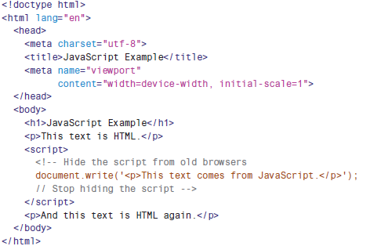
Understanding Dynamic Websites and
HTML 5 Applications
Example of Using javascript to print some text

Slide 21
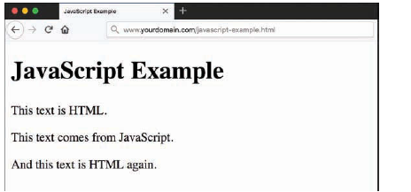
Understanding Dynamic Websites and
HTML 5 Applications
Output of Using javascript to print some text

Slide 22
Thinking Ahead to Developing HTML5
Applications
Although HTML5 is incredibly rich, the creation of highly interactive HTML5 websites and applications including mobile applications doesn’t happen in isolation. Interactivity comes when HTML5 is paired with a client-side language such as JavaScript, which then reaches back into the server and talks to a server-side language (PHP, Ruby, Python, and so on) through a persistent connection called a web socket.

Slide 23
Thinking Ahead to Developing HTML5
Applications
With this connection open and talking to some server-side code that is (for example) talking to a database or performing some calculation, the browser can relay a bundle of information that is additionally processed by JavaScript and finally rendered in HTML5.
The depth of the technologies involved in HTML5 application creation is beyond the scope of these lessons, but the foundation you should have in standards-compliant HTML5, CSS3, and JavaScript will serve you well if you begin to think outside the box of a basic website.

Slide 24
GETTING STARTED WITH JAVASCRIPT
PROGRAMMING

Slide 25
Getting Started with JavaScript
Programming
Statements
Statements are the basic units of a JavaScript program. A statement is a section of code that performs a single action.
Combining Tasks with Functions
A function is a number of JavaScript statements that are treated as a single unit. A statement that uses a function is referred to as a function call. For example, you might create a function called alertMe, which produces an alert when called like so: function alertMe() { alert("I am alerting you!"); }

Slide 26
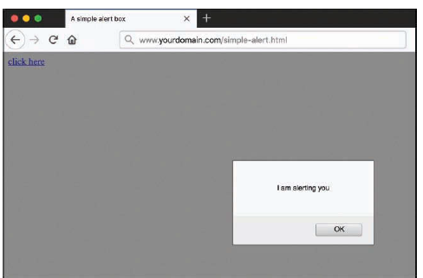
Getting Started with JavaScript
Programming
When this function is called, a JavaScript alert pops up, and the text “I am alerting you” is displayed in a box, as shown in Figure below

Slide 27
Getting Started with JavaScript
Programming
Variables
A variable is a container that can store a number, a string of text, or another value. For example, the following statement creates a variable called fred and assigns it the value 27:
var fred = 27;
JavaScript variables can contain numbers, text strings, and other values.

Slide 28
Getting Started with JavaScript
Programming
Understanding Objects
JavaScript also supports objects. Like variables, objects can store data—but they can store two or more pieces of data at once. Using built-in objects and their methods is fundamental to JavaScript; it’s one of the ways the language works, by providing a predetermined set of actions you can perform.

Slide 29
Getting Started with JavaScript
Programming
Conditionals
Although you can use event handlers to notify your script (and potentially the user) when something happens, you might need to check certain conditions yourself as your script runs. For example, you might want to validate on your own that a user entered a valid email address in a web form. JavaScript supports conditional statements, which enable you to answer questions. A typical
conditional uses the if statement, as in this example:
if (count == 1) { alert("The countdown has reached 1."); }

Slide 30
Getting Started with JavaScript
Programming
Loops
Another useful feature of JavaScript—and most other programming languages—is the capability to create loops, or groups of statements that repeat a certain number of times. For example, these statements display the same alert 10 times, greatly annoying the user:
for (i=1; i<=10; i++) { alert("Yes, it's yet another alert!"); }
The for statement is one of several statements JavaScript uses for loops.

Slide 31
Getting Started with JavaScript
Programming
Event Handlers
Each event handler is associated with a particular browser object, and you can specify the event handler in the tag that defines the object. For example, images and text links have an event, onmouseover, that happens when the mouse pointer moves over the object. Here is a typical HTML image tag with an event handler:
<img src="button.gif" onmouseover="highlight();">

Slide 32
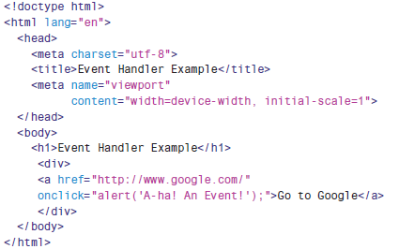
Getting Started with JavaScript
Programming
An HTML Document with a Simple Event Handler

Slide 33
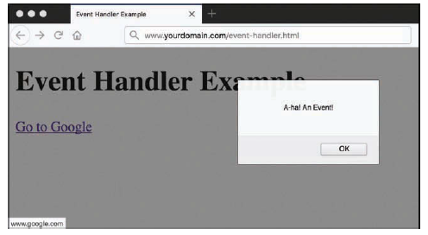
Getting Started with JavaScript
Programming
Output of a Simple Event Handler

Slide 34
Getting Started with JavaScript
Programming
JavaScript Syntax Rules
JavaScript is a simple language, but you do need to be careful to use its syntax the rules that define how you use the language correctly.
Variable, Object, and Function Names
When you define your own variables, objects, or functions, you can choose their names. Names can include uppercase letters, lowercase letters, numbers, and the underscore (_) character. Names must begin with a letter or an underscore.

Slide 35
Getting Started with JavaScript
Programming
Case Sensitivity
Almost everything in JavaScript is case sensitive, which means you cannot use lowercase and capital letters interchangeably. Here are a few general rules:
JavaScript keywords, such as for and if, are always lowercase.
Built-in objects, such as Math and Date, are capitalized.
DOM object names are usually lowercase, but their methods are often a combination of uppercase and lowercase sometimes called camel case. Usually uppercase letters are used to start all words except for the first one, as in setAttribute and getElementById.

Slide 36
Getting Started with JavaScript
Programming
Spacing
JavaScript ignores blank space (which programmers call whitespace). You can include spaces and tabs within a line, or blank lines, without causing an error. Blank space often makes a script more readable, so do not hesitate to use it.

Slide 37
Getting Started with JavaScript
Programming
Best Practices for JavaScript
Use comments liberally - Comments make your code easier for others to understand and also easier for you to understand when you edit it later. They are also useful for marking the major divisions of a script.
Use a semicolon at the end of each statement and use only one statement per line - Although you learned in this lesson that you do not have to end each statement with a semicolon (if you use a new line), using semicolons and only one statement per line will make your scripts easier to read and also easier to debug.

Slide 38
Getting Started with JavaScript
Programming
Use external JavaScript files whenever possible - Separating JavaScript into external files helps pages load more quickly and also encourages you to write modular scripts that can be reused.
Avoid being browser specific - As you learn more about JavaScript, you’ll learn some features that work in only one browser. Avoid such features unless absolutely necessary and always test your code in more than one browser to ensure that everything works.

Slide 39
Getting Started with JavaScript
Programming
Keep JavaScript optional - Don’t use JavaScript to perform an essential function on your site (for example, for the primary navigation links). Whenever possible, users without JavaScript should be able to use your site, although it might not be quite as attractive or convenient without the JavaScript. This strategy is known as progressive enhancement.

Slide 40
Getting Started with JavaScript
Programming
Understanding JSON
Although JSON, or JavaScript Object Notation, is not a part of the core JavaScript language, using it is in fact a common way to structure and store information either used by or created by JavaScript-based functionality on the client side. Now is a good time to familiarize yourself with JSON (pronounced “Jason”) and some of its uses.

Slide 41
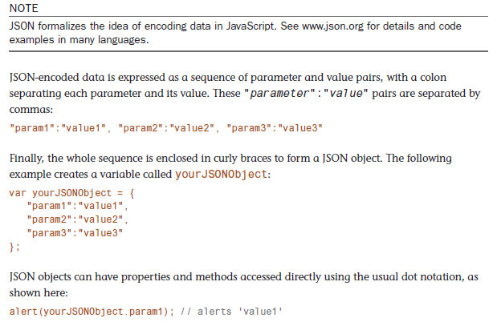
Getting Started with JavaScript
Programming

Slide 42
WORKING WITH THE DOCUMENT OBJECT
MODEL (DOM)

Slide 43
Working with the Document Object
Model (DOM)
One advantage of JavaScript over plain HTML is that client-side JavaScript scripts can manipulate the web browser and documents (including their contents) right in the browser after the content has been loaded. Your script can load a new page into the browser, work with parts of the browser window and the loaded document, open new windows, and even modify text within the page all dynamically, without requiring additional requests to a server.

Slide 44
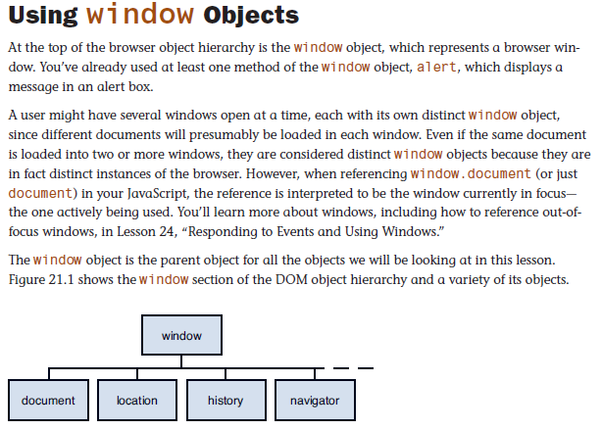
Working with the Document Object
Model (DOM)

Slide 45
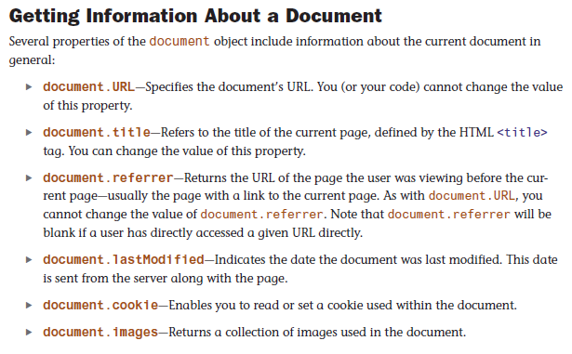
Working with the Document Object
Model (DOM)

Slide 46
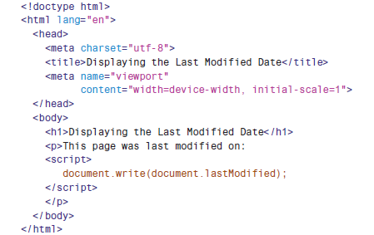
Working with the Document Object
Model (DOM)
Example of a HTML document that displays its last modified date using JavaScript.

Slide 47
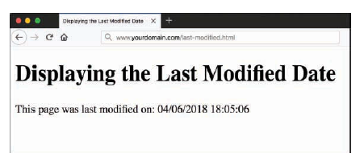
Working with the Document Object
Model (DOM)
Output of a HTML document that displays its last modified date using JavaScript.

Slide 48
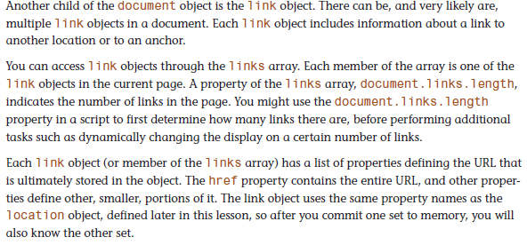
Working with the Document Object
Model (DOM)
Using Links

Slide 49
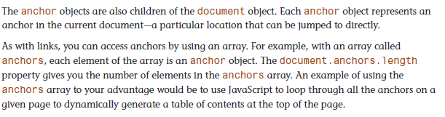
Working with the Document Object
Model (DOM)
Using Anchors

Slide 50
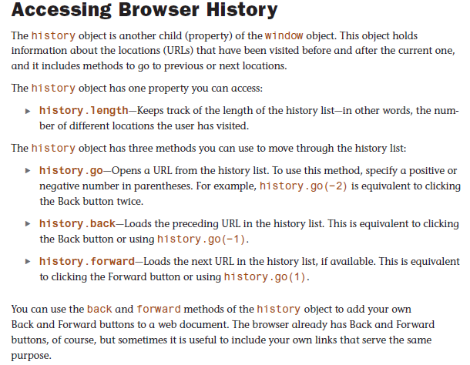
Working with the Document Object
Model (DOM)

Slide 51
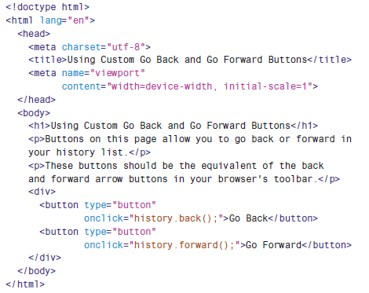
Working with the Document Object
Model (DOM)
Example of A Web Page That Uses JavaScript to Include Back and Go Forward Buttons

Slide 52
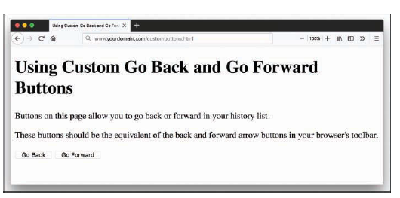
Working with the Document Object
Model (DOM)
Output of A Web Page That Uses JavaScript to Include Back and Go Forward Buttons

Slide 53
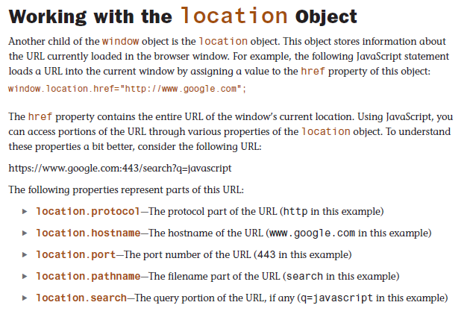
Working with the Document Object
Model (DOM)

Slide 54
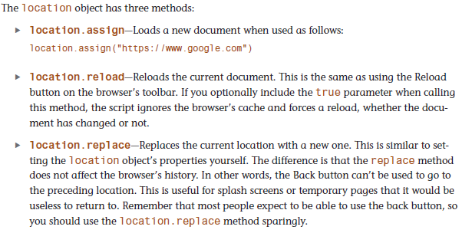
Working with the Document Object
Model (DOM)

Slide 55
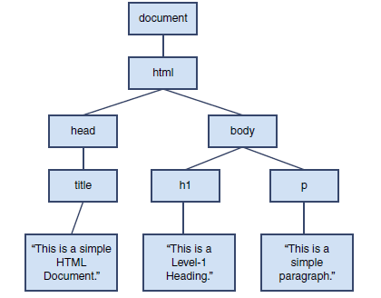
Working with the Document Object
Model (DOM)
Structure of DOM

Slide 56
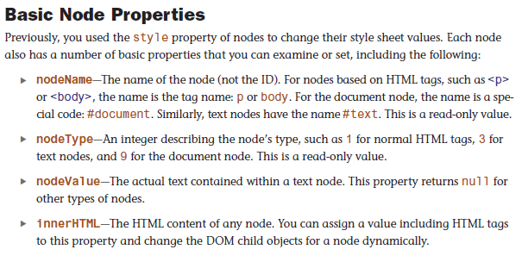
Working with the Document Object
Model (DOM)
DOM Nodes and its Properties

Slide 57
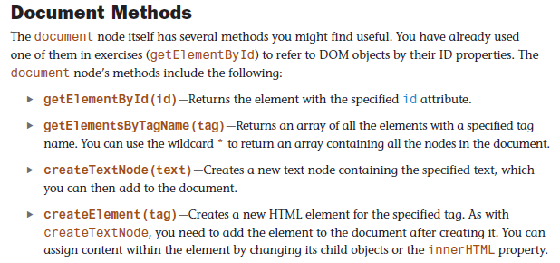
Working with the Document Object
Model (DOM)

Slide 58
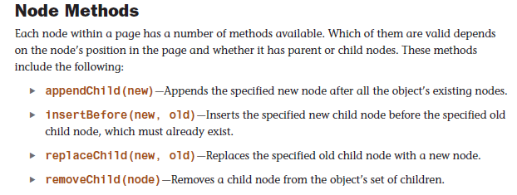
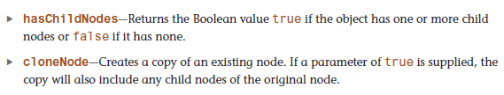
Working with the Document Object
Model (DOM)

Slide 59
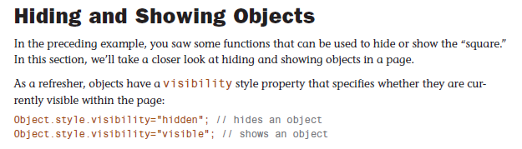
Working with the Document Object
Model (DOM)

Slide 60
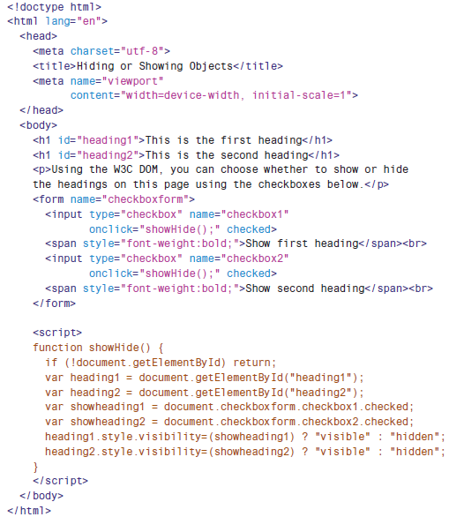
Working with the Document Object
Model (DOM)
Hiding and Showing Objects

Slide 61
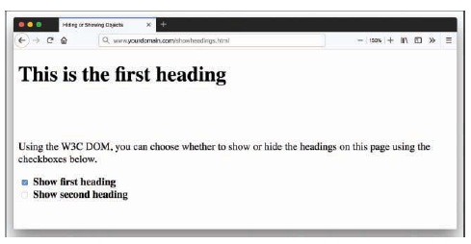
Working with the Document Object
Model (DOM)
Hiding and Showing Objects

Slide 62
USING JAVASCRIPT VARIABLES,
STRINGS AND ARRAYS

Slide 63
Using Javascript Variables,
Strings and Arrays
Using Variables
Unless you have skipped over all the JavaScript-related lessons so far, you’ve already used a few variables. You probably can also figure out how to use a few more without any additional help.
Nevertheless, there are some aspects of variables you haven’t learned yet, and they are covered in the next few sections.

Slide 64
Using Javascript Variables,
Strings and Arrays
Choosing Variable Names
Variable names can include letters of the alphabet, both upper- and lowercase. They can also include the digits 0–9 and the underscore (_) character.
Variable names cannot include spaces or any other punctuation characters.
The first character of the variable name must be either a letter or an underscore.
Variable names are case sensitive; for example, totalnum, Totalnum, and TotalNum are interpreted as separate variable names.

Slide 65
Using Javascript Variables,
Strings and Arrays
Using Local and Global Variables
Global variables have the entire script (and other scripts in the same HTML document) as their scope. They can be used anywhere, even within functions.
Local variables have a single function as their scope. They can be used only within the function they are created in.

Slide 66
Using Javascript Variables,
Strings and Arrays
To create a global variable, you declare it in the main script, outside any functions. You can use the var keyword to declare the variable, as in this example: var students = 25;
To create a local variable within a function, you must use the var keyword. This forces JavaScript to create a local variable, even if there is a global variable with the same name. However, try to keep your variable names distinct, even if you are using them in different scopes.

Slide 67
Using Javascript Variables,
Strings and Arrays
Understanding Expressions and Operators
Using JavaScript Operators
In the basic JavaScript examples so far in these lessons, you’ve already used some operators, such as the + sign (addition) and the increment and decrement operators

Slide 68
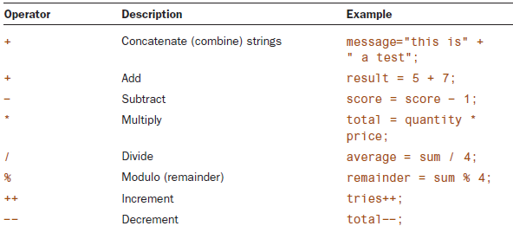
Using Javascript Variables,
Strings and Arrays
Common Javascript Operators

Slide 69
Using Javascript Variables,
Strings and Arrays
Data Types in JavaScript
In some computer languages, you have to specify the type of data a variable will store (for example, a number or a string). In JavaScript, you don’t need to specify a data type in most cases. However, you should know the types of data JavaScript can deal with.
These are the basic JavaScript data types:
Number - Examples of numbers are 3, 25, and 1.4142138. JavaScript supports both integers and floating-point numbers.

Slide 70
Using Javascript Variables,
Strings and Arrays
Boolean - Booleans are logical values. A Boolean can have one of two values, true or false, and is useful for indicating whether a certain condition is true.
String - A string, such as "I am a jelly doughnut", consists of one or more characters of text. (Strictly speaking, strings are String objects).
Null - The null value, represented by the keyword null, is the value of an undefined variable.

Slide 71
Using Javascript Variables,
Strings and Arrays
Converting Between Data Types
In some situations, you might end up with a string containing a number and need to convert it to a regular numeric variable. JavaScript includes two functions for this purpose:
parseInt - Converts a string to an integer number
parseFloat - Converts a string to a floating-point number

Slide 72
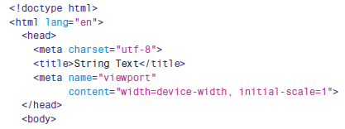
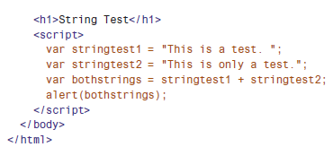
Using Javascript Variables,
Strings and Arrays
Assigning a Value using String Objects

Slide 73
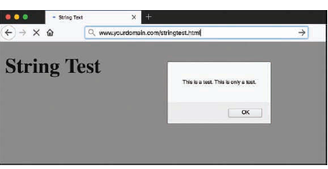
Using Javascript Variables,
Strings and Arrays
Output of Sample String Objects

Slide 74
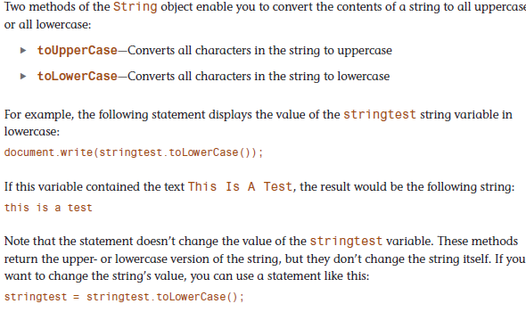
Using Javascript Variables,
Strings and Arrays
Converting the Case of a String

Slide 75
Using Javascript Variables,
Strings and Arrays
Working with Substrings
Using Part of a String
The substring method returns a string consisting of a portion of the original string between two index values, which you must specify in parentheses. For example, the following statement displays the fourth through sixth characters of the stringtest string:
document.write(stringtest.substring(3,6));

Slide 76
Using Javascript Variables,
Strings and Arrays
There are three things you need to understand about using index parameters, regardless of when you’re using them:
  Indexing starts with 0 for the first character of the string, so the fourth character is actually index 3.
  The second index is noninclusive. A second index of 6 includes up to index 5 (the sixth character).
  You can specify the two indexes in either order. The smaller one will be assumed to be the first index. In the previous example, (6,3) would produce the same result. Of course, there is rarely a reason to use the reverse order.

Slide 77
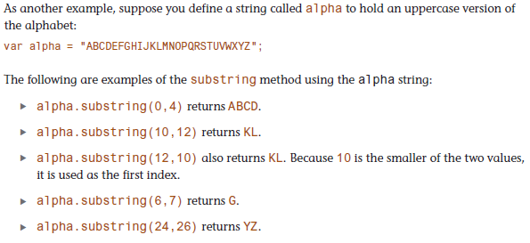
Using Javascript Variables,
Strings and Arrays

Slide 78
Using Javascript Variables,
Strings and Arrays
Getting a Single Character
Using the charAt method is a simple way to grab a single character from a specified position within a string. To use this method, specify the character’s index, or position, in parentheses. Here are a few examples of using the charAt method on the alpha string:
alpha.charAt(0) returns A
alpha.charAt(12) returns M
alpha.charAt(25) returns Z

Slide 79
Using Javascript Variables,
Strings and Arrays
Using Numeric Arrays
An array is a numbered group of data items that you can treat as a single unit. For example, you might use an array called scores to store several scores for a game.
Arrays can contain strings, numbers, objects, or other types of data. Each item in an array is called an element of the array.

Slide 80
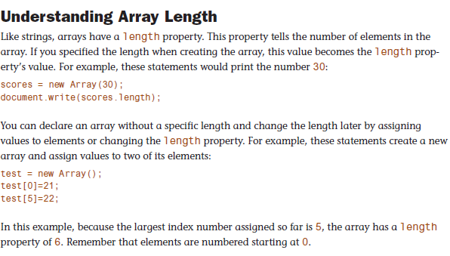
Using Javascript Variables,
Strings and Arrays

Slide 81
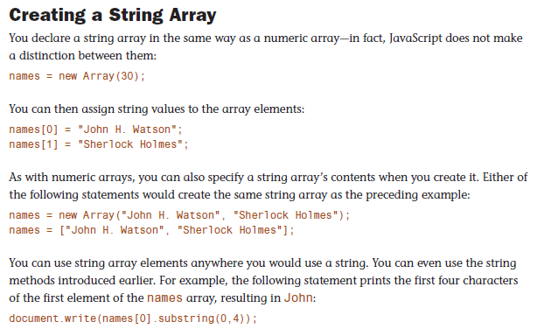
Using Javascript Variables,
Strings and Arrays

Slide 82
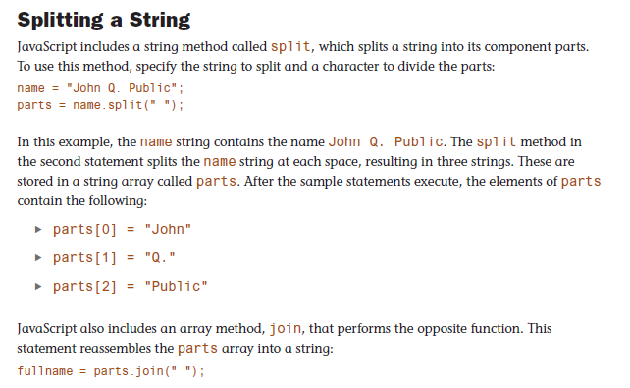
Using Javascript Variables,
Strings and Arrays

Slide 83
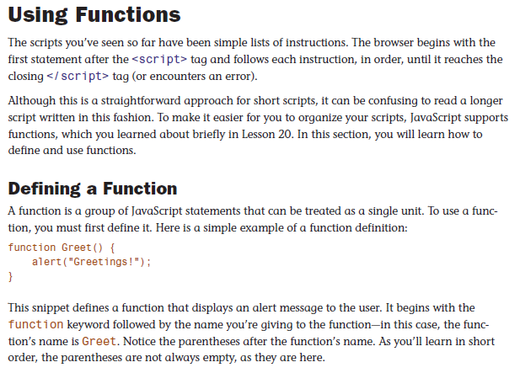
Using Javascript Variables,
Strings and Arrays

Slide 84
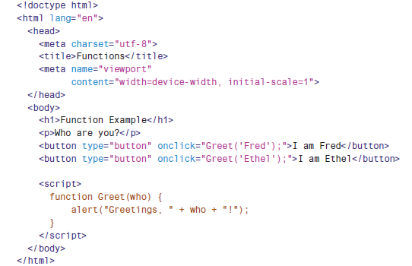
Using Javascript Variables,
Strings and Arrays
Complete Function Example

Slide 85
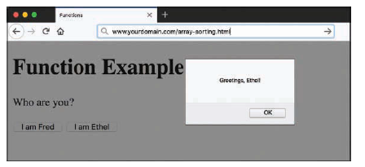
Using Javascript Variables,
Strings and Arrays
Output of a Complete Function Example

Slide 86
Using Javascript Variables,
Strings and Arrays
Introducing Objects
Although a variable can have only one value at a time, an object can contain multiple values, which enables you to group related data items into a single object.
DOM Objects - These objects enable your scripts to interact with elements of the web browser and web documents.
Built-in objects - These include strings and arrays, which you learned about previously in this lesson.

Slide 87
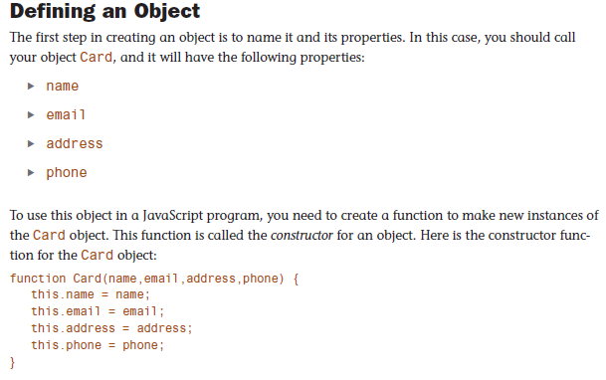
Using Javascript Variables,
Strings and Arrays

Slide 88
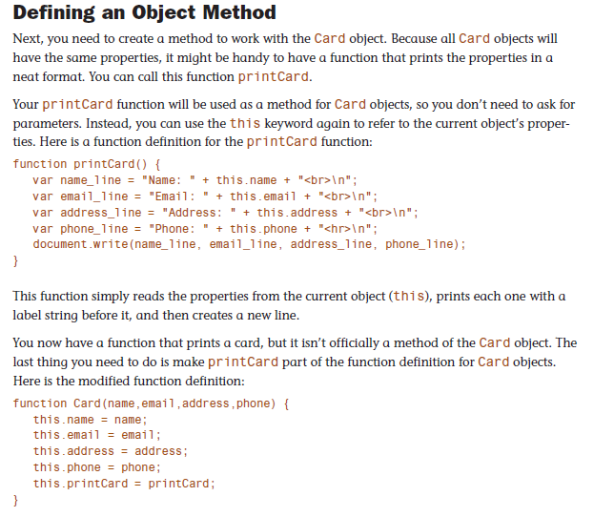
Using Javascript Variables,
Strings and Arrays

Slide 89
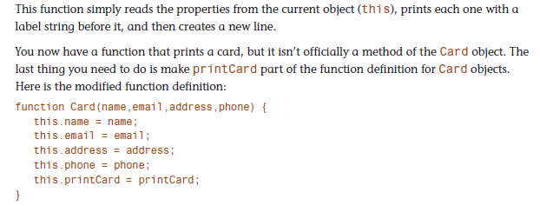
Using Javascript Variables,
Strings and Arrays

Slide 90
CONTROLLING FLOW WITH
CONDITIONS AND LOOPS

Slide 91
Controlling Flow With Conditions and Loops
Conditional Operators
The action part of an if statement can include any of the JavaScript statements you’ve already learned (and those you haven’t, for that matter), but the condition part of the statement uses its own syntax. This is called a conditional expression.
A conditional expression usually includes two values to be compared (in the preceding example, the values a and 1). These values can be variables, constants, or even expressions in themselves.

Slide 92
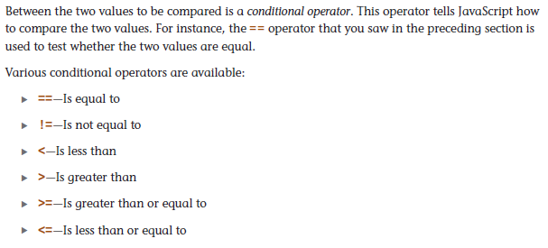
Controlling Flow With Conditions and Loops

Slide 93
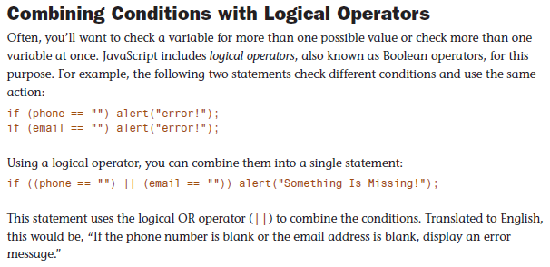
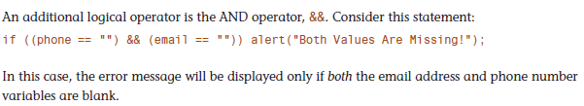
Controlling Flow With Conditions and Loops

Slide 94
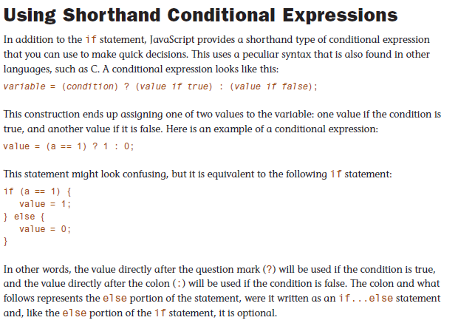
Controlling Flow With Conditions and Loops

Slide 95
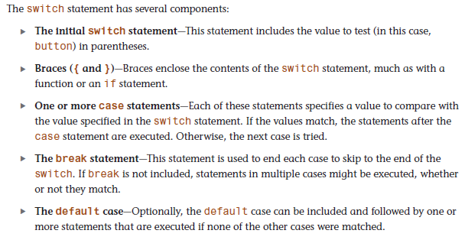
Controlling Flow With Conditions and Loops
Using Multiple Conditions with switch

Slide 96
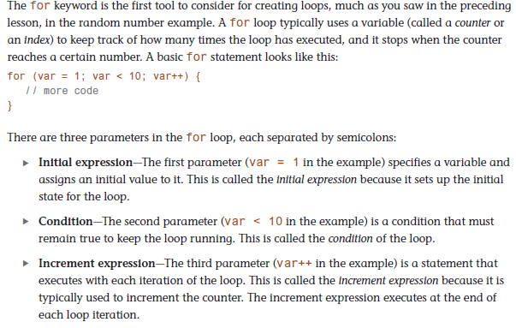
Controlling Flow With Conditions and Loops
Using for Loops

Slide 97
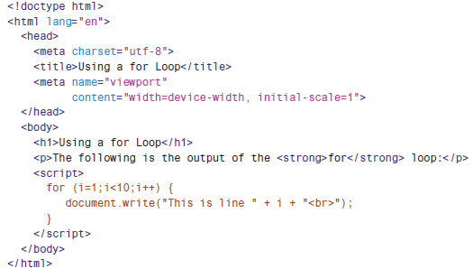
Controlling Flow With Conditions and Loops
Using the for Keyword

Slide 98
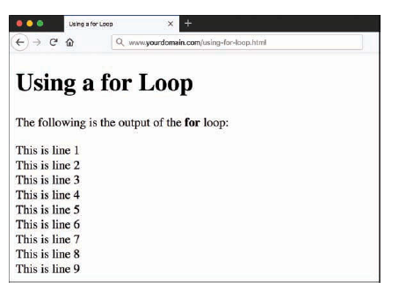
Controlling Flow With Conditions and Loops
Output of for Keyword

Slide 99
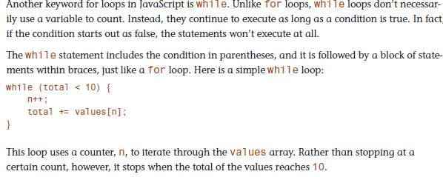
Controlling Flow With Conditions and Loops
Using While Loops

Slide 100
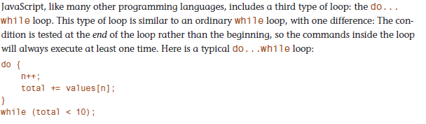
Controlling Flow With Conditions and Loops
Using do… While Loops

Slide 101

Controlling Flow With Conditions and Loops
Creating an Infinite Loops

Slide 102

Controlling Flow With Conditions and Loops
Looping Through Object Properties

Slide 103
RESPONDING TO EVENTS AND USING WINDOWS

Slide 104

Responding to Events and Using Windows
Understanding Event Handlers

Slide 105

Responding to Events and Using Windows
Supporting Multiple Event Handlers

Slide 106

Responding to Events and Using Windows
Supporting Multiple Event Handlers

Slide 107

Responding to Events and Using Windows
Using the Event Object

Slide 108

Responding to Events and Using Windows
Using Mouse Event

Slide 109

Responding to Events and Using Windows
Javascript File for the Mouse Click Example

Slide 110

Responding to Events and Using Windows
Javascript File for the Mouse Click Example

Slide 111

Responding to Events and Using Windows
Using the load and unload Events

Slide 112

Responding to Events and Using Windows
Controlling Windows with Objects

Slide 113

Responding to Events and Using Windows
Controlling Windows with Objects

Slide 114

Responding to Events and Using Windows
Controlling Windows with Objects

Slide 115

Responding to Events and Using Windows
Controlling Windows with Objects

Slide 116
JAVASCRIPT BEST PRACTICES

Slide 117
JavaScript Best Practices
Avoid Overusing JavaScript
An important best practice is to avoid overusing JavaScript. This might seem counterintuitive in lessons teaching you to become a competent developer using JavaScript, but it’s true. Because HTML5 and CSS3 have matured, and so has browser support for these advanced standards, there’s now much less reason to use JavaScript for some of the enhanced interactions that required it even just a few years ago. For example, some developers spent years crafting useful JavaScript-based form validation scripts, all of which have been rendered moot by the inclusion of native HTML5 form field validation.

Slide 118
JavaScript Best Practices
Many of the visual effects that once needed to be coded in JavaScript can now be achieved perfectly well using CSS. When both approaches are possible (for example, with image rollovers, animations, and some types of menus), CSS is usually preferable. It’s well supported across browsers. In the rare case that CSS isn’t supported, the page is rendered as standard HTML, usually creating a page that’s at least perfectly functional, even if it’s not so pretty.

Slide 119
JavaScript Best Practices
Users are likely to spend a lot of their Internet time on sites other than yours. Experienced Internet users become accustomed to popular interface components such as menus, breadcrumb trails, and tabbed browsing. These elements are popular, in general, because they work well, can be made to look good, and don’t require the user to read a manual first. Familiarity with a site’s operation will likely increase a user’s productivity more than the potential benefits of your all-new JavaScript-heavy whizz-bang design. And if users are more productive, they will be happier with your site and stay longer.

Slide 120
JavaScript Best Practices
Users in many areas of the world are still using outdated, underpowered, hand-me-down computers and might also have slow and/or unreliable Internet access and old versions of web browsers. The CPU cycles taken up by unnecessary JavaScript code might be precious to them.

Slide 121

JavaScript Best Practices

Slide 122
JavaScript Best Practices
Progressive Enhancement
The counterpart of graceful degradation is progressive enhancement, in which the primary development principle is to keep HTML documents as simple as possible so that they’ll definitely work in even the most primitive browsers. After you’ve tested that and made sure that the basic functionality is always available, you can dynamically add features that make the site easier to use or better looking for those with new browsers. If you add these features unobtrusively, they have little chance of preventing the site from working in its primitive HTML form.

Slide 123
JavaScript Best Practices
Here are some guidelines for progressive enhancement:
Enhance your site’s presentation by adding style rules to a separate CSS file. Try to avoid using HTML tags for presentation only, such as <b> for boldface or <blockquote> for an indented section.
Enhance behavior by adding scripts to an external JavaScript file.
Use feature sensing, described later in this lesson, to ensure that JavaScript code executes only on browsers that support the features it requires.

Slide 124

JavaScript Best Practices

Slide 125

JavaScript Best Practices

Slide 126


JavaScript Best Practices

Slide 127

JavaScript Best Practices
Reading Browser Information

Slide 128

JavaScript Best Practices
Displaying Browser Information

Slide 129

JavaScript Best Practices
Displaying Browser Information

Slide 130

JavaScript Best Practices
Dealing with Browser Quirks

Slide 131

JavaScript Best Practices
Avoiding Errors

Slide 132
USING THIRD-PARTY JAVASCRIPT
LIBRARIES AND FRAMEWORKS

Slide 133
Using Third-party Javascript Libraries
When you use JavaScript’s built-in and often-used Math and Date functions, JavaScript does most of the work, you don’t have to figure out how to convert dates between formats or calculate a cosine but can just use the function that JavaScript provides. Third-party libraries are libraries that are not directly included with JavaScript, but they serve a similar purpose: They enable you to do complicated things with only a small amount of code because that small amount of code refers to something bigger under the hood that someone else has already created.

Slide 134
Using Third-party Javascript Libraries
Although in general most people are big fans of third-party libraries, you should be aware of some of the common objections:
You won’t ever really know how the code works because you’re simply employing someone else’s algorithms and functions.
JavaScript libraries contain a lot of code you’ll never use but that the browser has to download anyway.

Slide 135

Using Third-party Javascript Libraries

Slide 136
Using Third-party Javascript Libraries
script.aculo.us
script.aculo.us by Thomas Fuchs is one such library. It includes functions to simplify drag-and drop tasks, such as rearranging lists of items. It also includes a number of combination effects, which enable you to use highlighting and animated transitions within your pages. For example, a new section of the page can be briefly highlighted in yellow to get the user’s attention, or a portion of the page can fade out or slide off the screen.

Slide 137

Using Third-party Javascript Libraries and Frameworks

Slide 138

Using Third-party Javascript Libraries and Frameworks

Slide 139

Using Third-party Javascript Libraries and Frameworks

Slide 140
THE FOUNDATION OF REACT

Slide 141
The Foundation of React
Let’s start with the name “React.” Facebook designed React in response to its need to be able to efficiently update websites in response to events.
Events that can trigger updates in websites include user input, new data coming into the application from other websites and data sources, and data coming into the application from sensors (such as location data from GPS chips).

Slide 142
The Foundation of React
Traditionally, the way that web applications have dealt with data that changes over time is to refresh themselves every so often, checking for new data in the process.
Facebook wanted to create a way to more easily build applications that respond, or react to new data, rather than simply refreshing pages whether the underlying data has changed or not.

Slide 143
The Foundation of React
UI LAYER
Web applications typically are built and described using the Model-View-
Controller (MVC) pattern.
The Model in MVC is the data layer, the Controller facilitates communication with the data layer, and the View is what the user sees and interacts with. In an MVC application, the View sends input to the Controller, which passes data between the data layer and the View.
React is only concerned with the V in MVC. It takes data as input and presents it to the user in some form.

Slide 144

The Foundation of React
The MVC Pattern

Slide 145
The Foundation of React
React itself doesn’t care whether the user is using a mobile phone, a tablet, a desktop web browser, a screen reader, a command-line interface, or any other kind of device or interface that may be invented in the future.
React just renders components. How those components get presented to the user is up to a separate library.
ReactDOM has a number of functions for interfacing between React and web browsers, but the one that every React application makes use of is called ReactDOM.render.

Slide 146

The Foundation of React
React and ReactDOM

Slide 147

The Foundation of React
Working Process of Virtual DOM

Slide 148
The Foundation of React
React vs.…
The job of being a software developer today, especially one working with JavaScript and the web, requires some knowledge of a staggeringly large and growing number of libraries, frameworks, protocols, standards, best practices, and patterns.
A great programmer not only knows how to apply whatever language and framework they are working in at any one time, but also how to quickly learn new languages and frameworks.

Slide 149
The Foundation of React
React Vs Angular
Angular (angular.io) was created by Google, and it’s been around longer than React in one form or another. Let’s start with the similarities:
1. Purpose - Both Angular and React can create scalable and dynamic user interfaces.
2. Stability - Both Angular and React were created by one of the largest companies on the internet and they both have huge numbers of developers and enthusiasts.

Slide 150
The Foundation of React
3. Robustness - A major concern with any JavaScript library or framework is how safe, secure, and generally acceptable it is for enterprise development. Both Angular and React are popular and widely used in corporate software development.
4. License - Both frameworks use the MIT license, which allows for unlimited use and reuse for free as long as the original copyright and license notices are included in any copy of the source code.

Slide 151
The Foundation of React
React Vs Vue
Vue.js (vuejs.org) is a relative newcomer to the universe of JavaScript frameworks, but it has been growing in popularity and is now considered one of the top three, along with React and Angular.
Like React and Angular, Vue is open source. Unlike React and Angular, however, Vue isn’t backed or controlled by a large corporation. Instead, it’s the work of many programmers and companies donating their skills to maintain and support it. This can be seen as either a plus or a minus, depending on your view of giant internet companies.

Slide 152
The Foundation of React
Vue takes a middle ground between the bare-bones approach of React and the smorgasbord approach of Angular. Like Angular, it has built-in functionality for state management, routing, and managing CSS.
But, like React, it’s a small library (even smaller than React in terms of total kilobytes that must be downloaded to the browser) and how you use it is highly customizable.

Slide 153

The Foundation of React
Differences between Front-end, Back-end and Development Environments

Slide 154
The Foundation of React
React Is Not a Web Server
A web server, also known as an HTTP server, has as its primary job to accept requests for web pages from web browsers and then return those web pages to the browser along with all of their linked images, CSS files, and JavaScript files.
React Is Not a Programming Language
React is a JavaScript library, which means that it is just a collection of JavaScript functions that programmers can make use of.

Slide 155
The Foundation of React
React Is Not a Database Server
React doesn’t have any abilities to store data in a secure way or in a permanent way. Instead, React user interfaces (like every web and mobile web user interface) communicate with server-side databases over the internet to store and receive data such as login information, ecommerce transaction data, news feeds, and so forth.

Slide 156
JSX

Slide 157
JSX
JSX is an XML-based syntax extension to JavaScript. In plain English, it’s a way to write JavaScript code using XML. Although it’s not specific to React, and it’s not even required in order to write React components.
JSX is an integral part of how every React developer writes components because it makes writing components so much easier and has no negative impact in terms of performance or functionality.
Misperception about React comes from and introduces JSX, which gives us an easy, HTML-like syntax for composing React components.

Slide 158

JSX

Slide 159

JSX

Slide 160

JSX

Slide 161

JSX

Slide 162


JSX

Slide 163
ALL ABOUT COMPONENTS

Slide 164
All About Components
What is a Component?
Components are the building blocks of React applications. A React component is a function or a JavaScript class that optionally accepts data and returns a React element that describes some piece of the user interface. A React user interface is made up of a hierarchy of components that build up to a single component (called the root component) that is rendered in the web browser. It’s possible to create a React application with only a single component, but for all but the smallest apps, breaking your app up into multiple components makes development and management of the code easier.

Slide 165

All About Components
A Tree of React Components

Slide 166
All About Components
Components Vs Elements
Before we talk about components, it’s important to understand the relationship between components and elements in React.
Components Define Elements
The job of a component is to return an element. Each component within an application has a unique name, which is how you use it. The component name becomes the name of the React element when you include a component in another component,

Slide 167

All About Components

Slide 168

All About Components

Slide 169

All About Components

Slide 170

All About Components

Slide 171

All About Components

Slide 172

All About Components

Slide 173

All About Components

Slide 174

All About Components

Slide 175

All About Components
The component Lifecycle

Slide 176

All About Components

Slide 177
EVENTS

Slide 178
Events
How Events work in React?
In HTML, it’s possible to use event attributes to call JavaScript functions. These event attributes have names starting with “on” and they take a function call as their value.
For example, the HTML onsubmit event attribute can be used with the <form> element to invoke a function when the form is submitted. Listing 7‑1 shows an example of using the HTML onsubmit attribute. This example assumes that a JavaScript function named validate() has been defined or imported elsewhere in the HTML file.

Slide 179

Events

Slide 180

Events

Slide 181


Events

Slide 182

Events

Slide 183

Events

Slide 184

Events

Slide 185

Events

Slide 186

Events

Slide 187
FORMS

Slide 188

Forms

Slide 189

Forms

Slide 190

Forms

Slide 191

Forms

Slide 192

Forms

Slide 193

Forms

Slide 194


Forms

Slide 195
REFS

Slide 196

Refs

Slide 197

Refs

Slide 198

Refs

Slide 199

Refs

Slide 200
STYLING REACT

Slide 201

Styling React

Slide 202

Styling React

Slide 203

Styling React

Slide 204

Styling React

Slide 205

Styling React

Slide 206

Styling React

Slide 207
ROUTING

Slide 208
Routing
What is Routing?
The most basic concept behind the web (what we call Web 1.0) is that a web browser requests a web page from a web (HTTP) server using a unique URL. The web server then responds with an HTML page that is rendered in the browser.
When a user clicks a link on a web page, it requests a new HTML page, which the browser downloads and displays instead of the current page. Browsers and servers maintain a user’s state between different web pages by using browser cookies, the localStorage API, and server-side data.

Slide 209

Routing
How the web works

Slide 210
Routing
JavaScript user interface libraries hijack the original request/response model that the web was built on. This works well, but it means that the browser is always displaying the same HTML page. This is what we call a single page application (SPA).
Having a website or web application that only consists of one web page makes it impossible for other sites to link to specific data within your app or site using a URL, and it makes it more difficult for search engines to index the data on your site or in your app. The solution is to have the JavaScript that runs your web application simulate the browser’s built-in ability to load web pages that correspond to unique URLs.

Slide 211

Routing
JavaScript Routing

Slide 212

Routing

Slide 213

Routing

Slide 214

Routing

Slide 215


Routing

Slide 216

Routing

Slide 217

Routing

Slide 218

Routing

Slide 219

Routing

Slide 220

Routing

Slide 221
HOOKS

Slide 222
Hooks
Hooks are functions that are part of the React library which give you access to features of React that were previously only available by extending the React.Component class. These features include state and lifecycle, as well as refs and caching of function results (aka memoization).
Hooks “hook into” React from functions. Hooks were introduced to solve several problems with the React library. The first is that React didn’t have a simple way to share reusable functionality between components. Prior to React Hooks, solutions such as higher-order components and render props

Slide 223
Rules of Hooks
Although different hooks accomplish different things, all of them have two important rules which must be followed:
1. Hooks can only be used in function components.
2. Hooks must be called at the top level of your function components—meaning
inside the function, but not inside of a statement or inner function. Because hooks need to run just once every time your function component runs, they can’t be called from inside of conditional statements, loops, or nested functions.

Slide 224

The Built-in Hooks

Slide 225
Writing Custom Hooks
Custom hooks are functions that make use of the built-in hooks to encapsulate reusable functionality. Many different custom hooks have been written and are available for free on the web, either by themselves as standalone components, or as features within React libraries. You can also write your own custom hooks.

Slide 226
Writing Custom Hooks
Custom hooks, like the built-in hooks, have names that start with use. This is a helpful convention rather than a requirement. To write a custom hook, write a function that uses at least one built-in hook and export a value from the function.
Listing 11‑17 shows a custom hook based on the zipcode lookup component from earlier in this chapter. When imported into a component, useZipLookup will take a zipcode as its argument and return an array containing the corresponding city and state.

Slide 227

Writing Custom Hooks

Slide 228

LABELING CUSTOM HOOKS WITH USEDEBUG VALUE

Slide 229

LABELING CUSTOM HOOKS WITH USEDEBUG VALUE

Slide 230

FINDING AND USING CUSTOM HOOKS

Slide 231

FINDING AND USING CUSTOM HOOKS

Slide 232

FINDING AND USING CUSTOM HOOKS

Slide 233

FINDING AND USING CUSTOM HOOKS

Slide 234

FINDING AND USING CUSTOM HOOKS

